Slide 1
NBA Shot selection data model

Slide 2
Agenda
Introduction
The Data
The Process
The Discoveries
Final tips & takeaways

Slide 3

Introduction:
The NBA is highly competitive, and optimizing shot selection can significantly impact game outcomes.

Slide 4
The Dataset
Collected data from the NBA 2023 season.
Features include player position, shot area, shot distance, game quarter, minutes left, etc.
With multiple variables delivered, are we able to predict the shot outcome based on these parameters?

Slide 5
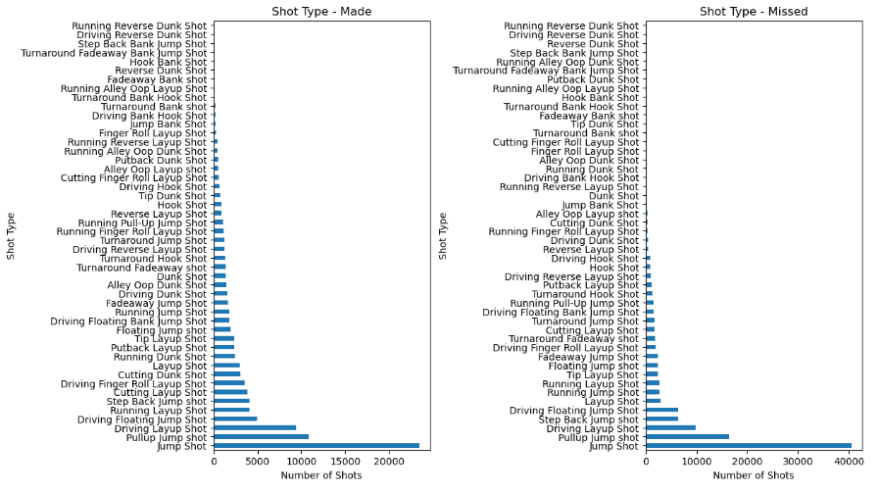
At face value…
What are the most common shots successfully sunk?

Slide 6
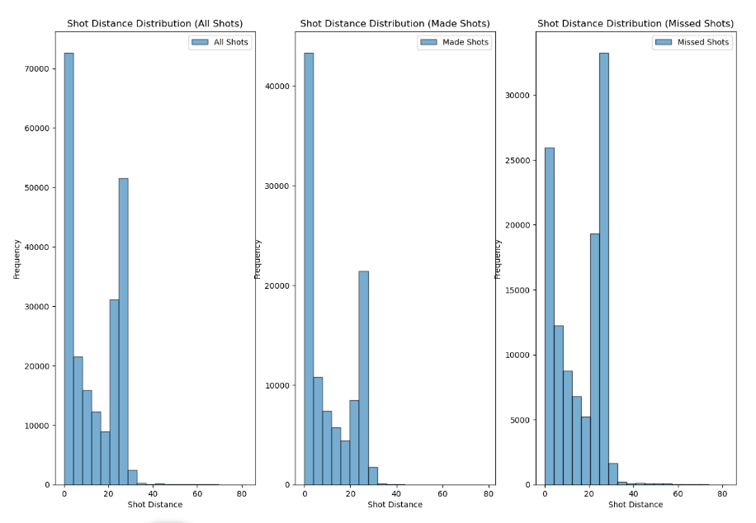
Continued…

Slide 7
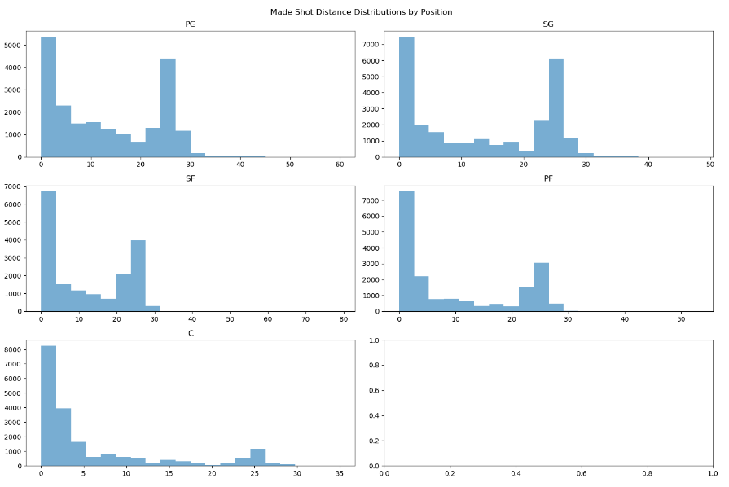
One more!

Slide 8

The process
What was done to our dataset?

Slide 9

Pre-Processing and Models
Data cleaning: removed duplicates, handled missing values.
Feature scaling: standardized numerical features.
Encoding: transformed categorical features into numerical values.
Data cleaning: removed duplicates, handled missing values.
Feature scaling: standardized numerical features.
Encoding: transformed categorical features into numerical values.

Slide 10

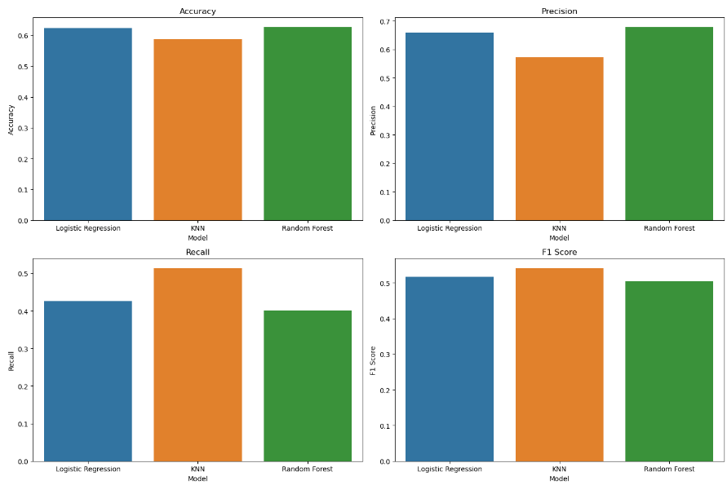
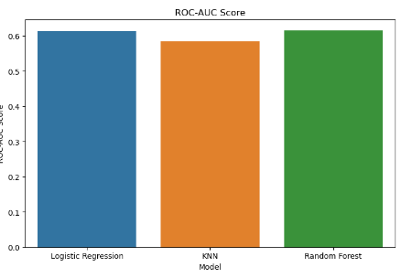
Initial model findings
Looking good but still with some to be desired.

Slide 11
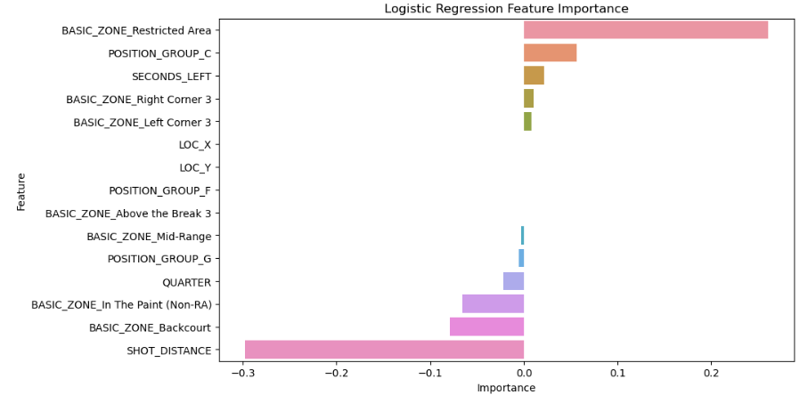
Discoveries: logistic Regression best performing features?
Restricted Area
Center Position
Seconds Left

Slide 12
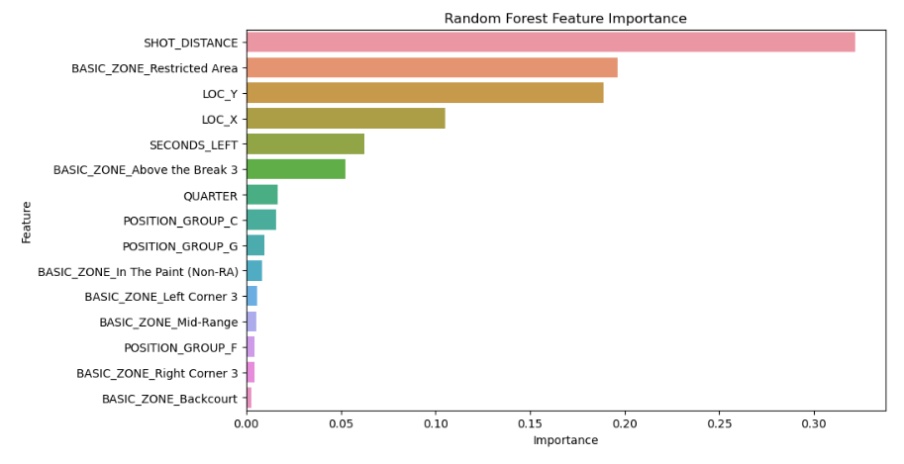
Discoveries: random Forest best performing features?
Shot Distance
Restricted Area
Location

Slide 13
Conclusions
Some limitations include:
  Analysis restricted to the 2023
  Limited feature engineering
  Variables don’t point strongly enough to a base model
  Could benefit from more deep learning
However, what we accomplished is:
  Our Random Forest establishes a solid stepping stone for predicting field goals in future models
  The strength of certain variables can prove great for players and coaches
  Expanding upon the dataset can provide greater opportunity

Slide 14
THANK YOU
Luis Vallesteros
540-313-0078

